Slide 1
Virtual Circuit (VC)
Networks like ATM or Frame Relay networks implement VC.
A VC consists of following three components
  A Path – A series of links and routers between source and destination
  VC Numbers – An ID number for each link along the path.
  Entries in forwarding table of EACH router along the path.
  Note: For each link, interface no. is different from VC no. Also, one interface can be associated with many VCs.
  Every packet carries a VC number in its header
  Each intervening router replaces the VC number of each traversed packet with a new VC number
  The new VC number was obtained from the forwarding table, example:

Slide 2

Forwarding Table in VC
VC number
12
22
32
1
3
2
interface
number
Forwarding table in router:
Incoming interface Incoming VC # Outgoing interface Outgoing VC #
1 12 3 22
2 63 1 18
3 7 2 17
1 97 3 87
… … … …
Routers maintain connection state information!

Slide 3
Phases in Virtual Circuit:
VC setup – Determining the series of links and switches through which all packets of the VC will travel.
Data transfer - Once the VC has been established, data can begin to flow along the VC.
Virtual circuit teardown - inform the end system about call termination, and update the tables in each of the packet switches on the path to indicate that the VC no longer exists.
Note: In TL connection set-up, the routers within the network are unaware of the connection. Whereas in NL, routers are involved in VC set-up and aware of all the VCs passing through it.

Slide 4
Datagram Networks
Put destination IP address and send it over the network.
Internet is Datagram Network.
NO call setup at network layer
ROUTERS: NO state information about end-to-end connections
  no network-level concept of “connection”
Packets forwarded using destination host address
  packets between same source-destination pair may take different paths
application
transport
network
data link
physical
application
transport
network
data link
physical
1. Send data
2. Receive data

Slide 5
Datagram Networks
Each router uses the packet’s destination address to forward the packet.
Each router has a forwarding table that maps destination address to the link interfaces.
The router matches a prefix of the packet’s destination address with the entries in the table; if there is a match, the router forwards the packet to a link associated with the match. Uses Longest Prefix Matching Rule.
Example Forwarding Table for Datagram Network:
PREFIX MATCH | LINK INTERFACE
11001000 00010111 00010 _ _ _ _ _ _ _ _ _ _ | 0
11001000 00010111 00011000 _ _ _ _ _ _ _ _ | 1
11001000 00010111 00011_ _ _ _ _ _ _ _ _ _ | 2
Otherwise | 3

Slide 6
Private Network
Private IP network is an IP network that is not directly connected to the Internet
IP addresses in a private network can be assigned arbitrarily.
  Not registered and not guaranteed to be globally unique
Generally, private networks use addresses from the following experimental address ranges (non-routable addresses):
  10.0.0.0 – 10.255.255.255
  172.16.0.0 – 172.31.255.255
  192.168.0.0 – 192.168.255.255

Slide 7
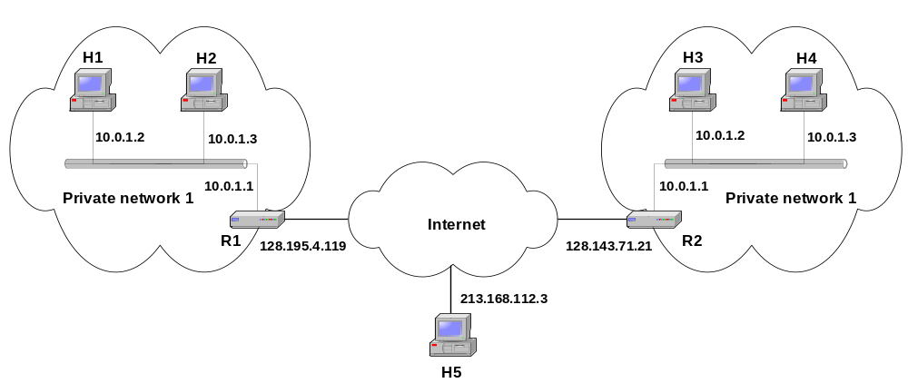
Private Addresses

Slide 8
Network Routing Algorithms

Slide 9
Routing
“That enables small local networks to be linked together to form potentially huge internetworks that can span cities, countries or even the entire globe”
  The job is done by special devices called Routers, which forward datagrams from network to network, allowing any device to send datagram to any other: even if the source has no idea where the destination is

Slide 10
In Summary:
Routers decide how to forward a datagram based on its destination address, which is compared to information the router keeps in special routing tables
These tables contain entries for each of the networks the router knows about, telling the router which adjacent router the datagram should be sent to in order for it to reach its eventual destination

Slide 11
Manual Vs Automatic
Manual Updation by Administrator:
  Tedious
  Time Consuming
  Static Approach
Modern Approach: Automatic
  Dynamic
  The information exchange b/w routers is accomplished through the use of routing protocols

Slide 12
Network Performance Measures
Two Performance Measures
  Quantity of Service (Throughput)
    How much data travels across the net?
    How long does it take to transfer long files?
  Quality of Service (Average packet delay)
    How long does it take for a packet to arrive at its destination?
    How responsive is the system to user commands?
    Can the network support real-time delivery such as audio and video?

Slide 13
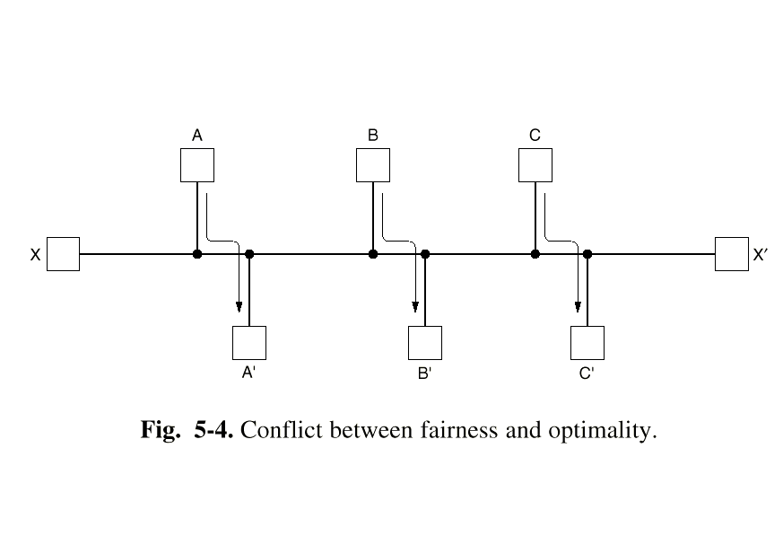
Fairness versus Optimality
Quantity of service versus quality of service.
To optimize throughput, saturate paths between A and A’, B and B’, and C and C’, but what happens to the response time from X to X’?

Slide 14
Routing
Terminology
  Default Router – To whom the host is attached directly.
  Source Router – Default router of the source host.
  Destination Router – Default router of destination host.
  Each connecting link has a certain cost.
  GOOD path = Least cost path
  Network is represented as graph G=(N,E). Set of N nodes and collection of E edges/links.
  If the cost of all the links in the network is same, then
  Least-Cost path = Shortest path (A path with smallest number of links bet source and destination pair)

Slide 15
Routing Algorithms: Classification
Non-adaptive (Static)
  based on a fixed topology, traffic, performance metric
  Not change, unless there is a major network overhaul
  Static routes are downloaded at boot time
Adaptive Algorithms
  Change routes dynamically
    Gather information at runtime
      locally
      from adjacent routers
      from all other routers
    Change routes
      Every delta T seconds
      When load changes
      When topology changes
Other
  Flooding
  Broadcasting
Routing algorithms
Static
Adaptive
others
Centralized / Global (based on all info)
OR
Link State Routing
Example:
Dijkstra’s Algorithm
Decentralized (on incomplete info)
Example:
Distance-Vector Routing

Slide 16
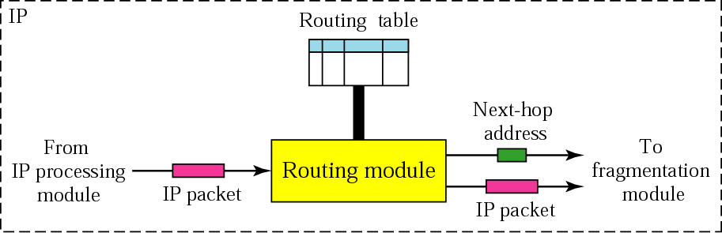
Routing Module And Routing Table

Slide 17
Adaptive Routing

Slide 18
Adaptive Routing
Centralized / Global/ Link-state routing – Dijkstra’s Algo
Distance-vector routing
Others
  Hierarchical routing
Standards
  OSPF
  BGP

Slide 19
Link State Routing
Two phases
Phase 1: Reliable Flooding
  Initial state: Each node knows the cost to its neighbors
  Final State: Each node knows the entire graph(N/w topology)
Phase 2: Route Calculation
  Each node uses Dijkstra’s algorithm on the graph to calculate optimal routes to all the nodes

Slide 20
Link State Routing: Dijkstra’s (Least Cost Path) Algorithm
Dijkstra’s algorithm
Network topology, link costs known to all nodes
  accomplished via “link state broadcast”
  all nodes have same info
Computes least cost paths from one node (‘source”) to all other nodes
  gives forwarding table for that node
Iterative: after k iterations, know least cost path to k dest.’s
Notation:
c(x,y): link cost from node x to y; = ∞ if not direct neighbors
D(n): current value of cost of path from source to dest.n
p(n): predecessor node of n, along the current least-cost path from source to n
N’ : set of nodes whose least-cost path is definitively known

Slide 21
Dijsktra’s Algorithm
Assumption: Source is u. Destination is n.
D(n) = min( D(n), D(w) + c(w,n) )

Slide 22
Dijsktra’s Algorithm - Least-Cost Path Routing
Step
0
1
2
3
4
5
N'
u
ux
uxy
uxyv
uxyvw
uxyvwz
D(v),p(v)
2,u
2,u
2,u
D(w),p(w)
5,u
4,x
3,y
3,y
D(x),p(x)
1,u
D(y),p(y)
∞
2,x
D(z),p(z)
∞
∞
4,y
4,y
4,y
5
v
3
w
2
5
u
2
1
z
3
1
x
y
2
1

Slide 23
Dijsktra’s Algorithm - Least-Cost / Shortest Path Routing
Resulting shortest-path (when cost of each link is same) tree from u:
Resulting forwarding table in u:
destination
link
v
w
v
(u,v)
u
z
x
(u,x)
y
(u,x)
x
y
w
(u,x)
z
(u,x)
Note: The number of times the loop given in the algorithm is executed is equal to the number of nodes in the network

Slide 24
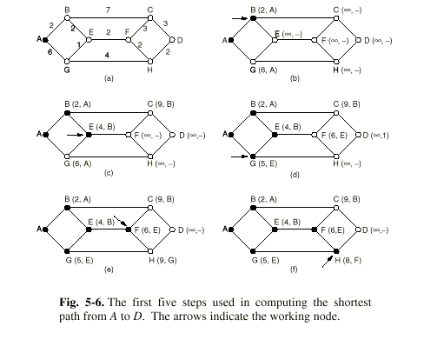
Example of Shortest Path Routing

Slide 25
Adaptive Routing
Centralized / Global/ Link-state routing – Dijkstra’s Algo
Distance-vector routing
Others
  Hierarchical routing
Standards
  OSPF
  BGP

Slide 26
Distance Vector Routing Algorithm
DVR Algorithm has got following properties:
Distributed – Each node receives some information from one or more of its directly attached neighbours.
Iterative – This process continues on until no more information is exchanged between neighbours.

Slide 27
Distance Vector Algorithm - Bellman-Ford Equation
DV Algo. is based on Bellman-Ford Equation
Let
d_{x}(y) = cost of least-cost path from x to y
c(x,v) =cost to each neighbor v, from x
Then
d_{x}(y) = min {c(x,v) + d_{v}(y) }
where min is taken over all neighbors of x; and v belongs to the set of neighbors of x.
This solution to Bellman-Ford Equation provides the entries in the forwarding table of node x

Slide 28
Bellman-Ford Example
To compute the path from u to z.
Clearly, d_{v}(z) = 5, d_{x}(z) = 3, d_{w}(z) = 3
5
v
3
w
2
5
u
2
1
z
3
1
2
x
y
1
Node that achieves minimum value is the next hop in shortest path ➜ forwarding table
According to Bellman-Ford equation:
d_{u}(z) = min { [c(u,v) + d_{v}(z)], [c(u,x) + d_{x}(z)], [c(u,w) + d_{w}(z)] }
= min {[2 + 5], [1 + 3], [5 + 3]} = 4

Slide 29
Distance Vector Algorithm - Concept
Basic idea:
Each node periodically sends its own distance vector estimate to all neighbors v.
When a node x receives new DV estimate from its neighbor, it update its own DV using B-F equation:
To compute the cost from X to Y:
D_{x}(y) = min_{v}{c(x,v) + D_{v}(y)} for each node y ∊ N

Slide 30
Distance Vector: Link Cost Changes
Link cost changes:
node detects local link cost change
updates routing info, recalculates
distance vector
if DV changes, notify neighbors
1
y
4
1
x
z
50
At time t₀, y detects the link-cost change, updates its DV,
and informs its neighbors.
At time t₁, z receives the update from y and updates its table.
It computes a new least cost to x and sends its neighbors its DV.
At time t₂, y receives z’s update and updates its distance table.
y’s least costs do not change and hence y does not send any
message to z.
“good
news
travels
fast”
Time

Slide 31
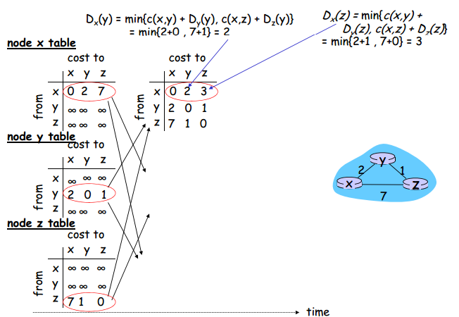

Slide 32
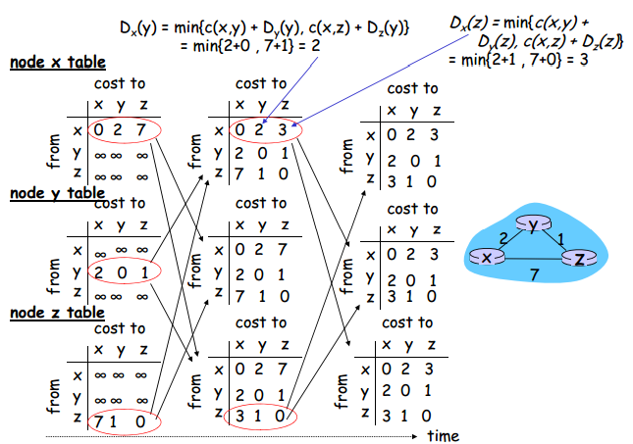

Slide 33
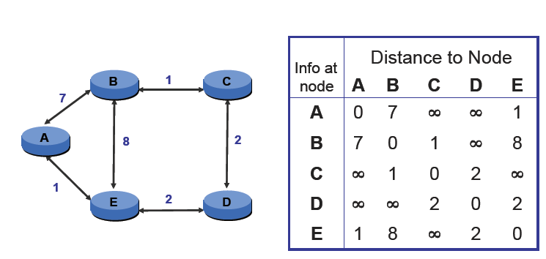
Another Example

Slide 34
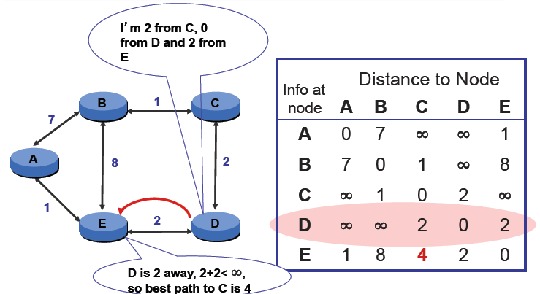
D Sends Vector to E

Slide 35
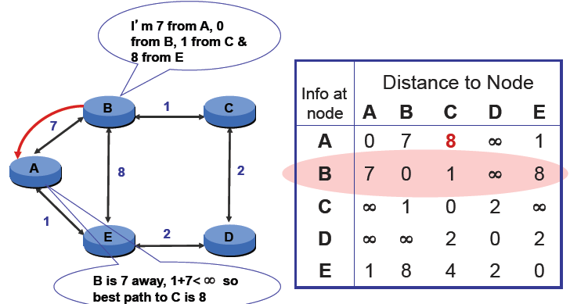
B Sends Vector to A

Slide 36
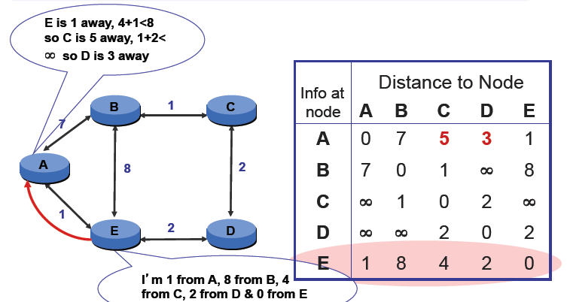
E Sends Vector to A

Slide 37
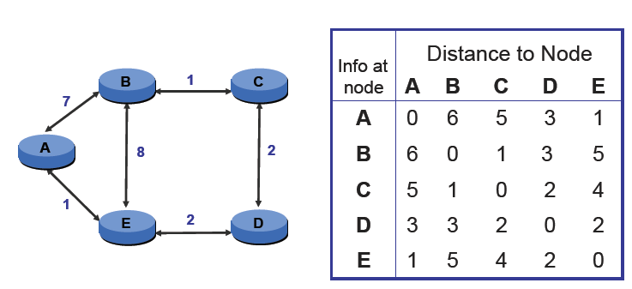
… Until Convergence

Slide 38
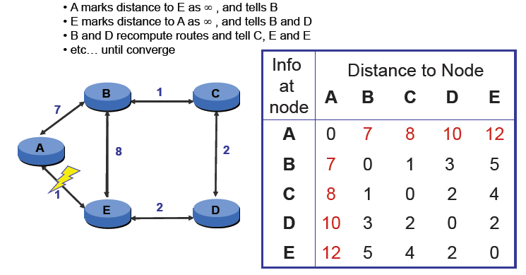
Handling Link Failures

Slide 39
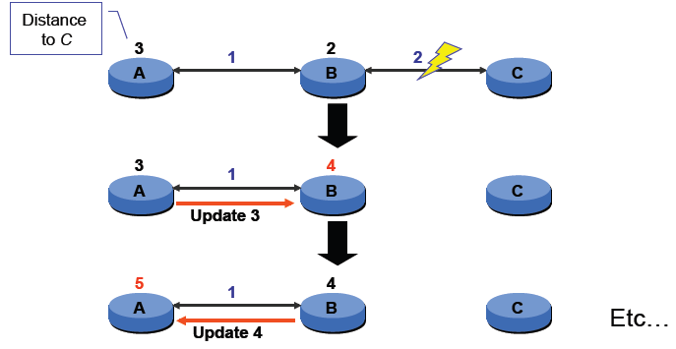
Counting to Infinity

Slide 40
Comparison of LS and DV algorithms - Summary
Distance Vector Routing:
Tell neighbors about distance of all the destination
Node’s computation depends on neighbors
Each router maintains distance vector, (dist , cost) tuple per
destination
Periodically send copy of distance vector to all neighbors
Link State Routing :
Tell about distance to each neighbor to all routers
Each router computes its best paths

Slide 41
Comparison of LS and DV algorithms
1. Message complexity
LS: with n nodes, E links, O(nE) msgs sent
DV: exchange between neighbors only
2. Speed of Convergence
LS: O(n²) algorithm requires O(nE) msgs
DV: convergence time varies
  may be routing loops
  count-to-infinity problem
3. Robustness : what happens if router malfunctions?
LS:
  node can advertise incorrect link cost
  each node computes only its own table
DV:
  DV node can advertise incorrect path cost
  each node’s table used by others
    error propagate thru network

Slide 42
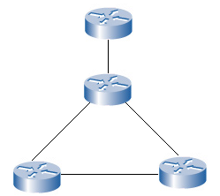
Broadcasting Routing
Method 1. Source Duplication (N-way Unicasting)
  Most straightforward way to send a broadcast packet, to each destination is to make N copies, one for every user. And then send one to each user.
  Drawback: Inefficient: uses a lot of bandwidth for one line.

Slide 43
Broadcasting Routing
Method 2. Network Duplication
  Using the network to create and distribute the copies.
  Use of Flooding: sending to all neighbors in the network.

Slide 44
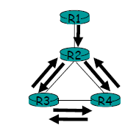
Broadcasting Routing: Flooding
Uncontrolled Flooding
  A fatal flaw with flooding.
Graph with cycles: the packet will cycle indefinitely
More then two neighbors: Will create a broadcast storm.

Slide 45
Broadcasting Routing: Flooding
Controlled Flooding
  SNCF(Sequence-number-controlled flooding)
A source node puts its address and broadcast sequence number into a broadcast packet.
The source sends the packet to all of its neighbors.
Each node maintains a list of the source address and sequence number of each broadcast packet it has received.
When a node receives a broadcast packet, it checks whether the packet is in the list. If so, the packet is dropped, otherwise, the packet is duplicated and forwarded.

Slide 46
Broadcasting Routing: Flooding
Controlled Flooding
  RPF (Reverse Path Forwarding)
  the router forwards only the packets that have traveled the shortest path from the source to the router; all other
  copies are discarded.
  Each router has to know the next neighbour on its unicast shortest path to the sender.

Slide 47
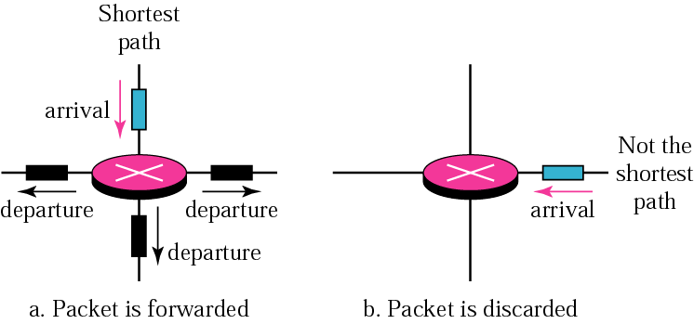
  RPF (Reverse Path Forwarding)

Slide 48
Broadcasting Routing: Spanning Tree Broadcast
Spanning-Tree Broadcast
    Limits number of sent packets.
    Creates a path for each node to forward received packets: A so called minimum spanning-tree.
    Nodes forward copies only along spanning tree.
    This is done by routing algorithms.

Slide 49
Spanning Tree Broadcast
A
A
B
B
c
c
D
D
F
E
F
E
G
G
(a) Broadcast initiated at A
(b) Broadcast initiated at D

Slide 50
Broadcasting Routing: Spanning Tree
Creating a Center Based Spanning-tree
  A central node is defined.
  Each node simultaneously sends a unicast join message to the center node
    Message forwarded Until it arrives at either the center node or a node that’s already a part of the tree.
A
A
3
B
B
c
c
4
2
D
D
F
E
F
E
1
5
G
G
Stepwise construction of spanning tree (E)
(b) Constructed spanning tree

Slide 51
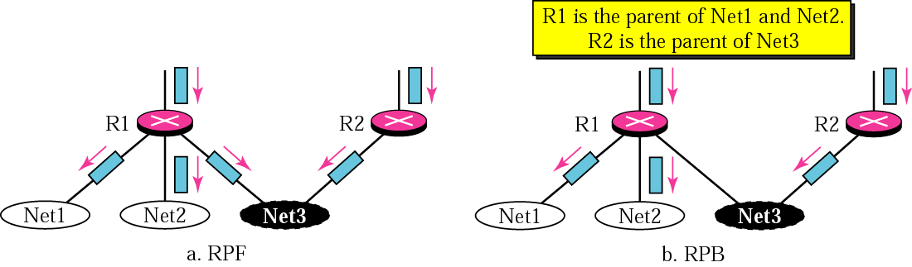
RPF Versus RPB
In RPB:
  The router with the shortest path to the source becomes the designated parent of a network
  A Router forwards packets only to its designated child networks

Slide 52
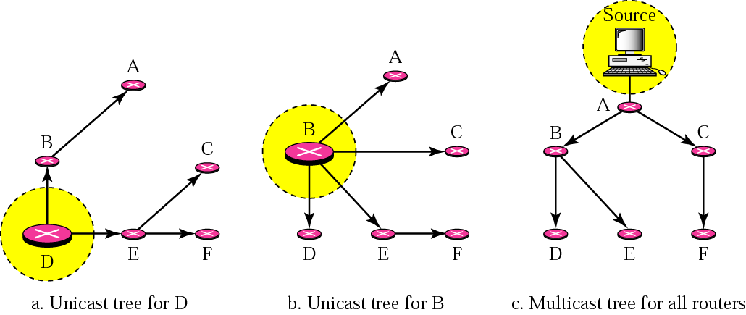
Multicast Routing

Slide 53
Multicast Routing
A method to broadcast packets to well-defined groups
Objectives
Every member receives EXACTLY ONE copy of the packet
Non-members receive nothing
No loops in route
Optimal path from source to each destination.
Terminology
Spanning Tree: Source is the root, group members are the leaves.
Shortest Path Spanning Tree: Each path from root to a leaf is the shortest according to some metric

Slide 54
Multicast Routing
Specific Receivers
How to identify the receivers of a packet.
How to address a packet sent to these receivers.
  We can not have all the addresses in the packet because it would be too big.
A multicast packet is sent by address indirection:
    A single identifier for all the receivers.
    This is done by a multicast group.
Notes:
Notes:
3.3 Network Layer: Multicast Routing Algorithms 3-9

Slide 55
Multicast Routing
Managing a Group
IGMP(Internet group management protocol).
  Provides the means for a host to inform the router that it wants to join a multicast group.
  IGMP has 3 message types, used for management of the group:
    Membership_Query For joining the group
    Membership_Report For acknowledgements
    Leave_Group For leaving the group

Slide 56
Multicasting Routing Algorithms
Multicasting routing using a Group-shared tree:
  Group uses one tree
  Similar to the spanning-tree broadcast.
  May use nodes not in the group to “jump” between different parts of the group.
Multicasting routing using a Source-based tree:
  One tree per source; shortest path trees
  Using a RPF(reverse path forwarding) algorithm, each node gets its own spanning tree.
  This is better when many users wants to communicate with many users.

Slide 57
Multicasting Routing Algorithms
Shared tree
Source-based trees

Slide 58
Adaptive Routing
Centralized / Global/ Link-state routing – Dijkstra’s Algo
Distance-vector routing
Others
  Hierarchical routing
Standards
  OSPF
  BGP

Slide 59
Hierarchical Routing
Our routing study so far:
all routers identical
network is “flat”
… not true in practice
scale: with 200 million destinations:
can’t store all dest’s in routing tables!
routing table exchange would swamp links!
administrative autonomy
internet = network of networks
each network admin may want to control routing in its own network

Slide 60
Hierarchical Routing
aggregate routers into regions, “autonomous systems” (AS)
routers in same AS run same routing protocol
  “intra-AS” routing protocol
  routers in different AS can run different intra-AS routing protocol
Gateway router
Direct link to router in another AS

Slide 61
Interconnected ASes
3c
3a
2c
3b
2a
AS3
2b
1c
AS2
1a
1b
1d
AS1
Forwarding table is configured by both intra- and inter-AS routing algorithm
  Intra-AS sets entries for internal dests
  Inter-AS & Intra-As sets entries for external dests
Intra-AS
Routing
algorithm
Inter-AS
Routing
algorithm
Forwarding
table

Slide 62
Inter-AS Tasks
Suppose router in AS1 receives datagram for which dest is outside of AS1
  Router should forward packet towards on of the gateway routers, but which one?
AS1 needs:
to learn which dests are reachable through AS2 and which through AS3
to propagate this reachability info to all routers in AS1
Job of inter-AS routing!
3c
3a
2c
3b
2a
AS3
2b
1c
AS2
1a
1b
1d
AS1

Slide 63
Example: Setting Forwarding Table In Router 1d
Suppose AS1 learns from the inter-AS protocol that subnet x is reachable from AS3 (gateway 1c) but not from AS2.
Inter-AS protocol propagates reachability info to all internal routers.
Router 1d determines from intra-AS routing info that its interface I is on the least cost path to 1c.
Puts in forwarding table entry (x,I).

Slide 64
Example: Choosing Among Multiple Ases
Now suppose AS1 learns from the inter-AS protocol that subnet x is reachable from AS3 and from AS2.
To configure forwarding table, router 1d must determine towards which gateway it should forward packets for dest x.
This is also the job on inter-AS routing protocol!
Hot potato routing: send packet towards closest of two routers.
Use routing info
from intra-AS
protocol to determine
costs of least-cost
paths to each
of the gateways
Determine from
forwarding table the
interface I that leads
to least-cost gateway.
Enter (x,I) in
forwarding table
Learn from inter-AS
protocol that subnet
x is reachable via
multiple gateways
Hot potato routing:
Choose the gateway
that has the
smallest least cost

Slide 65
Intra-AS Routing
Also known as Interior Gateway Protocols (IGP)
Most common Intra-AS routing protocols:
  RIP: Routing Information Protocol
  OSPF: Open Shortest Path First
  IGRP: Interior Gateway Routing Protocol (Cisco proprietary)

Slide 66
RIP ( Routing Information Protocol)
Distance vector algorithm
Included in BSD-UNIX Distribution in 1982
Distance metric: # of hops (max = 15 hops)
u
v
destination hops
u 1
v 2
w 2
x 3
y 3
z 2
A
B
w
x
z
C
D
y

Slide 67
RIP Advertisements
Distance vectors: exchanged among neighbors every 30 sec via Response Message (also called advertisement)
Each advertisement: list of up to 25 destination nets within AS

Slide 68
RIP: Example
z
w
x
y
A
D
B
C
Destination Network Next Router Num. of hops to dest.
w A 2
y B 2
z B 7
x -- 1
…. …. ....
Routing table in D

Slide 69
RIP: Example
Dest Next hops
w - -
x - -
z C 4
…. … ...
Advertisement
from A to D
z
w
x
y
A
D
B
C
Destination Network Next Router Num. of hops to dest.
w A 2
y B 2
z B A 7 5
x -- 1
…. …. ....
Routing table in D

Slide 70
RIP: Link Failure and Recovery
If no advertisement heard after 180 sec --> neighbor/link declared dead
  routes via neighbor invalidated
  new advertisements sent to neighbors
  neighbors in turn send out new advertisements (if tables changed)
  link failure info quickly propagates to entire net
  poison reverse used to prevent ping-pong loops (infinite distance = 16 hops)

Slide 71
RIP Table processing
RIP routing tables managed by application-level process called route-d (daemon)
advertisements sent in UDP packets, periodically repeated
routed
routed
Transprt
(UDP)
Transprt
(UDP)
network forwarding
(IP) table
network
(IP)
forwarding
table
link
link
physical
physical

Slide 72
OSPF (Open Shortest Path First)
“open”: publicly available
Uses Link State algorithm
  LS packet dissemination
  Topology map at each node
  Route computation using Dijkstra’s algorithm
OSPF advertisement carries one entry per neighbor router
Advertisements disseminated to entire AS (via flooding)
  Carried in OSPF messages directly over IP (rather than TCP or UDP

Slide 73
OSPF “advanced” features (not in RIP)
Security: all OSPF messages authenticated (to prevent malicious intrusion)
Multiple same-cost paths allowed (only one path in RIP)
For each link, multiple cost metrics for different TOS (e.g., satellite link cost set “low” for best effort; high for real time)
Integrated uni- and multicast support:
  Multicast OSPF (MOSPF) uses same topology data base as OSPF
Hierarchical OSPF in large domains.

Slide 74

Hierarchical OSPF

Slide 75
Hierarchical OSPF
Two-level hierarchy: local area, backbone.
  Link-state advertisements only in area
  each nodes has detailed area topology; only know direction (shortest path) to nets in other areas.
Area border routers: “summarize” distances to nets in own area, advertise to other Area Border routers.
Backbone routers: run OSPF routing limited to backbone.
Boundary routers: connect to other AS’s.

Slide 76
Internet inter-AS routing: BGP
BGP (Border Gateway Protocol): the de facto standard
BGP provides each AS a means to:
  Obtain subnet reachability information from neighboring ASs.
  Propagate the reachability information to all routers internal to the AS.
  Determine “good” routes to subnets based on reachability information and policy.
Allows a subnet to advertise its existence to rest of the Internet: “I am here”

Slide 77
BGP basics
Pairs of routers (BGP peers) exchange routing info over semi-permanent TCP conctns: BGP sessions
Note that BGP sessions do not correspond to physical links.
When AS2 advertises a prefix to AS1, AS2 is promising it will forward any datagrams destined to that prefix towards the prefix.
  AS2 can aggregate prefixes in its advertisement
3c
3a
2c
3b
2a
AS3
2b
1c
AS2
1a
1b
AS1
1d
eBGP session
iBGP session

Slide 78
Distributing reachability info
With eBGP session between 3a and 1c, AS3 sends prefix reachability info to AS1.
1c can then use iBGP do distribute this new prefix reach info to all routers in AS1
1b can then re-advertise the new reach info to AS2 over the 1b-to-2a eBGP session
When router learns about a new prefix, it creates an entry for the prefix in its forwarding table.
3c
3a
2c
3b
2a
AS3
2b
1c
AS2
1a
1b
AS1
1d
eBGP session
iBGP session

Slide 79
Path attributes & BGP routes
When advertising a prefix, advert includes BGP attributes.
  prefix + attributes = “route”
Two important attributes:
  AS-PATH: contains the ASs through which the advert for the prefix passed: AS 67 AS 17
  NEXT-HOP: Indicates the specific internal-AS router to next-hop AS. (There may be multiple links from current AS to next-hop-AS.)
When gateway router receives route advert, uses import policy to accept/decline.

Slide 80
BGP messages
BGP messages exchanged using TCP.
BGP messages:
  OPEN: opens TCP connection to peer and authenticates sender
  UPDATE: advertises new path (or withdraws old)
  KEEPALIVE keeps connection alive in absence of UPDATES; also ACKs OPEN request
  NOTIFICATION: reports errors in previous msg; also used to close connection

Slide 81
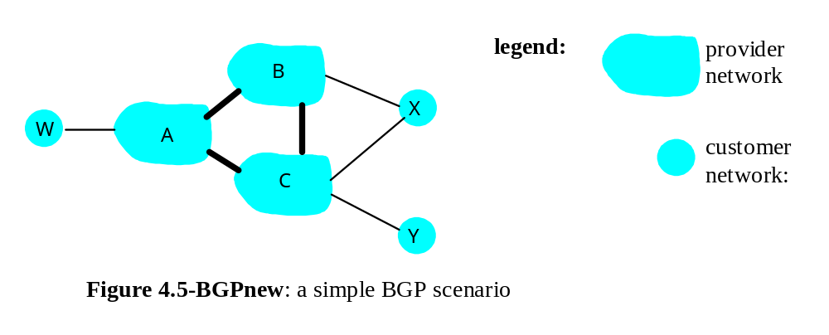
BGP routing policy
A,B,C are provider networks
X,W,Y are customer (of provider networks)
X is dual-homed: attached to two networks
  X does not want to route from B via X to C
  .. so X will not advertise to B a route to C

Slide 82
BGP routing policy (2)
A advertises to B the path AW
B advertises to X the path BAW
Should B advertise to C the path BAW?
  No way! B gets no “revenue” for routing CBAW since neither W nor C are B’s customers
  B wants to force C to route to w via A
  B wants to route only to/from its customers!

